Slide 1
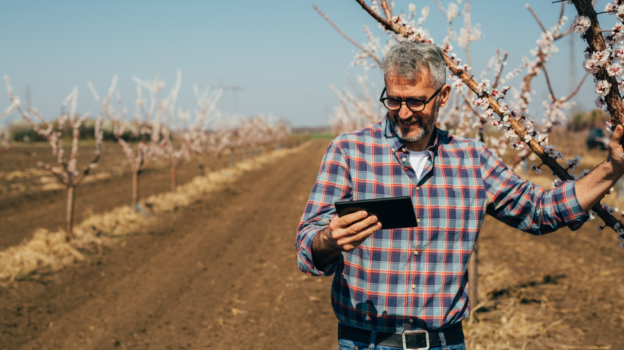

Response to Sony ????
www.farmx.co

Slide 2
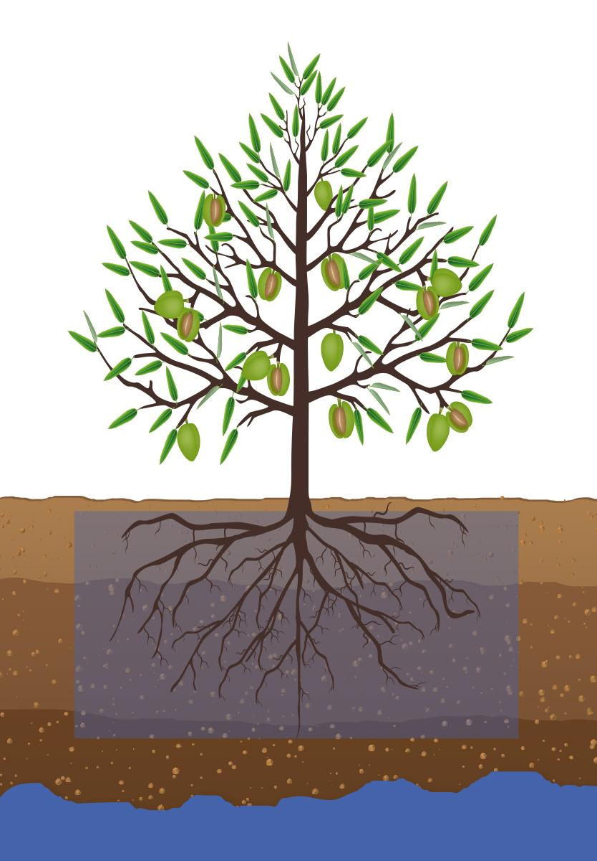
Growers tell us what they want to know about their farms
How vibrant is my plant canopy? Plenty of water & chlorophyll?
Is the water distribution uniform in the farm? Does my irrigation have leaks?
Are there any anomalies in my farm?
Does my plants have any pest infestations or disease?
Can I receive suggestions of what to do? Not just data.
When should I water? How often? How much? Am I overwatering
Will there be a frost? Bad enough to act?
Are my plants getting the right amount of nutrients?
What will be my yield?
Notes:
QUESTION; ROOTS DON’T GROWN NEATLY. NEED EXAMPLES.
Satellite, aerial image

Slide 3
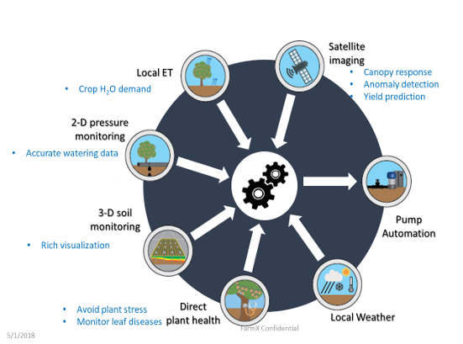
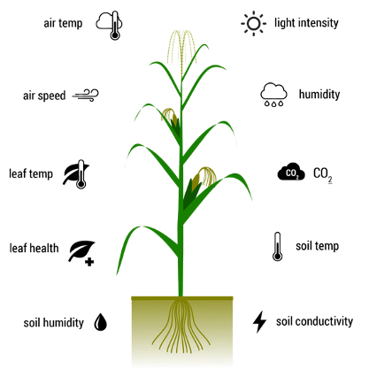





You need this information to answer those questions

Slide 4
Monitor & report on the entire plant: from roots to tips
How our competitors answer these questions:
Farm(x) is the only company to combine all the required data sources:
Some companies recommend with data from the sky
Weather
Canopy Imaging
In plant health / Stress
+ Soil Conditions
+ Irrigation Status
+ Automation status
Some companies recommend with data within the canopy
Some companies recommend with soil

Slide 5
To get this information, we started to assemble these data
We started with | We found we needed | Our response
Satellite Imaging data | Good but not granular enough | Modelling but need better data
CIMIS weather data | Hyperlocal weather not enough | Satellite + hyperlocal
3rd party soil probes for soil conditions, water | Better accuracy, all soil types | Built our own
 | Better determination of where irrigated water was | Built our own water pressure sensor
NOAA frost warnings | microclimate frost prediction, spatially and at different heights | Built a frost modelling and simple infrastructure

Slide 6
We need these data sets. Built systems to accurately collect
Data Needed | Farm(x) Usage | Sensor(s) | Farm(x) or 3rd party | Company using data
 |  |  |  | FarmX | CropX | Arable
Imagery | NDVI, NDWI | Satellite, aerial | 3rd party | ✓ | ✓ | ✓
Weather | ETc, Chill Portions, Irrigation Management | Rain, wind, temp, humidity, solar flux | 3rd party | ✓ |  | ✓
Plant Health | Crop Stress, Irrigation Management | Infrared Radiometer, Dendrometer | 3rd ird party | ✓ |  | ✓
Sub-surface Soil Moisture | Irrigation Management | Sub-surface soil moisture sensor | FarmX | ✓ | ✓ | ✓
Irrigation Water Pressure | Irrigation Management | Water Pressure Sensor | FarmX | PSI |  | On/Off
Water Flow | Irrigation Management | Water Flow Counter | 3rd party | ✓
System Health | System & battery Health | RF RSSI, Power Stats | FarmX | ✓ | ✓ | ✓
Leaf Wetness | Pest Pressure, Disease Risk, Plant Health | Leaf Wetness | 3rd party | ✓
Frost | Frost Prediction and mitigation | Bud/Leaf Frost, Inversion Layer Frost | 3rd party | ✓

Slide 7
Our journey
Tree variables to manage a farm.
Built a platform to collect the data set
After time, we found not getting good enough data using used 3rd party sensor
- Not very good
- too narrow a field
We built our own
BTW, it’s better than other
We want great imaging sensing. Satellite,
exhaustive amount of work on imaging. Want higher resolution imaging. We want a partner.
Imaging sensing technology
Our path….
slide: our probe versus other guys probes

Slide 8
Our journey v2
We wanted to provide a comprehensive crop management solution
We needed certain data
We knew modeling using AI and ML was essential
We tried 3rd party solutoins = 1 slide == 3rd party solutions available in market. Column = what we need…..
not good
Built our own 2nd slide == our solution are building vs list in 1st slide -- demonstrate our technical depth
Couple with AI and ML
Same challenge with imaging solutions in market
Taichi’s slide
Want a partner -->Sony

Slide 9
Platform Data Requirements
9

Slide 10
Soil Sensor Comparison
Vendor | Features | Soil Types | Zones in 48” probe | Measure volume per zone: 48” probe | Battery operation: 48” probe | Cost for 48” probe
FarmX | Moisture, Temperature, Salinity | Loam, Sand, Silt, Clay | Eight | 3.534 cubic feet | 18 months | $300
Arable (OEM from Sentek) | Moisture, Temperature, Salinity | Loam, Sand, Silt, Clay | Twelve | 0.116 cubic feet | 6 months | $800 (Sensor & bridge)
CropX | Moisture, Temperature | Loam, Sand, Silt, Clay | Three | 0.200 cubic feet | Solar Powered | $900 for 3 zones - 36” depth
AquaCheck | Moisture, Temperature | Loam, Sand, Silt | Six | 0.223 cubic feet | 12 months | $450

Slide 11
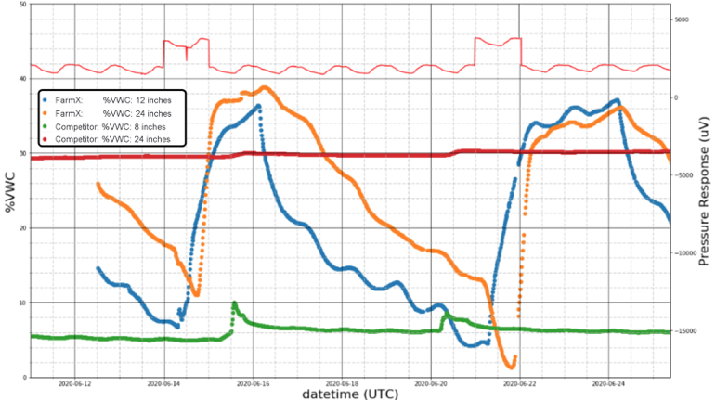
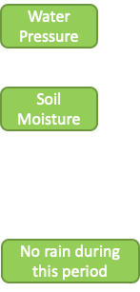
FarmX vs. Competitor: Soil Moisture in Clay
FarmX’s PIXL Soil Moisture probe accuracy in the challenging Clay Soil has world class performance exceeding the performance of competitive probes.

Slide 12
Discussion items
Existing our customer’s challenges
Potential solutions with UAV
Sensors / Technical collaboration
How do we achieve to productization?

Slide 13
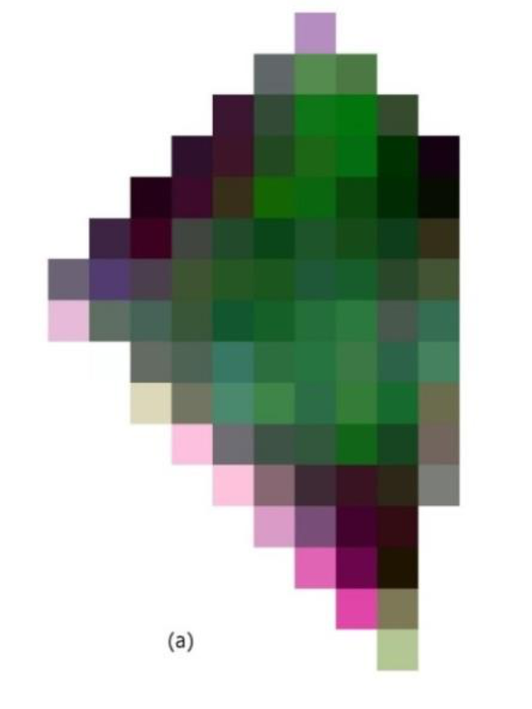
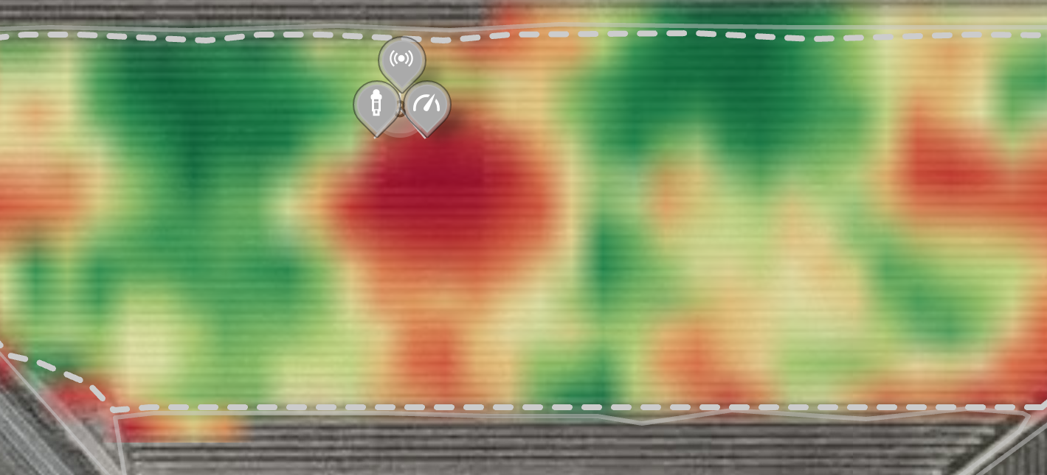
Existing our customer’s challenges
Category | Topic | Growers’ demand | Current service to grower by FarmX | Challenges
Interpretation | Visual analysis | Check field condition remotely | Visualize satellite image on FarmMap | The spatial resolution (>10m) of satellite data is not enough for visual analysis. (can’t identify each tree)
Recommendation | Water stress | Acknowledge as early as possible for optimal irrigation operation. | Direct measurement with IR sensors /dendrometers | Acquired data is point base (small coverage by IR, single tree attached with a dendrometer) Whole area can’t be measured for now.
Recommendation | Pest | Acknowledge quickly for avoiding spreading pest further | Nothing | No measure for now
Prediction | Yield prediction | Planning harvesting and selling/buying strategy | Our original yield prediction model by block level | Actual yield historical need to be prepared by growers Output resolution depends on resolution of actual yield data(by block, by points)
Historical data
Prediction in coming year
Block | Yield
A | 32
B | 14
… | …
D | 25
Block | Yield
A | 12
B | 19
… | …
D | 21
Yield prediction model
Train
Prediction
Position of Ground sensor on NDVI map from satellite data
Brief flow of our yield prediction
Satellite image of vineyard

Slide 14
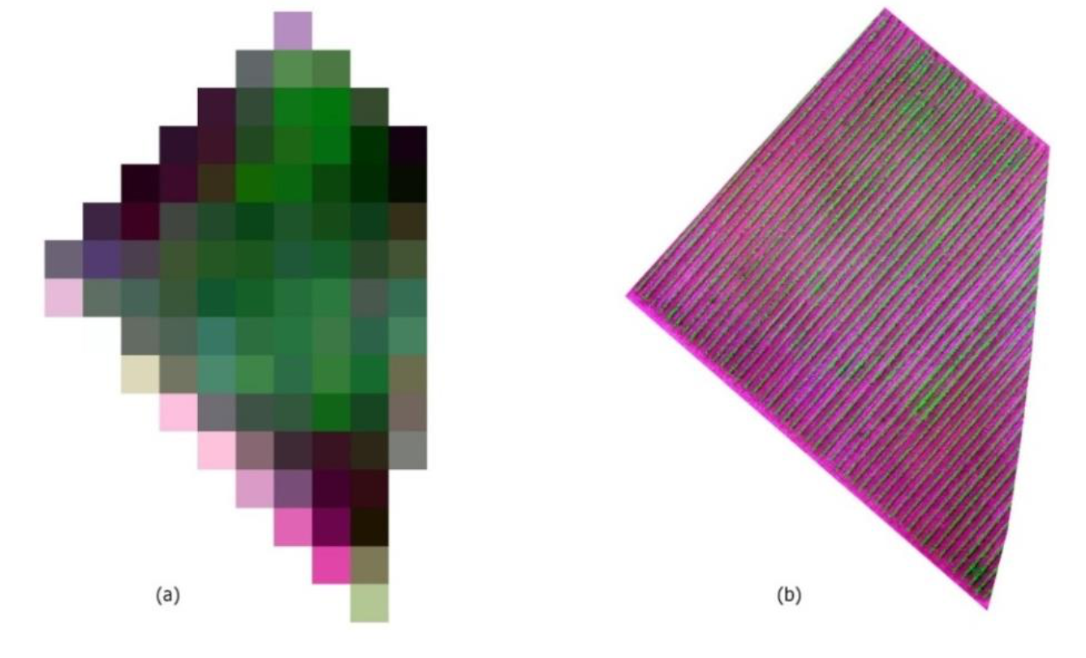
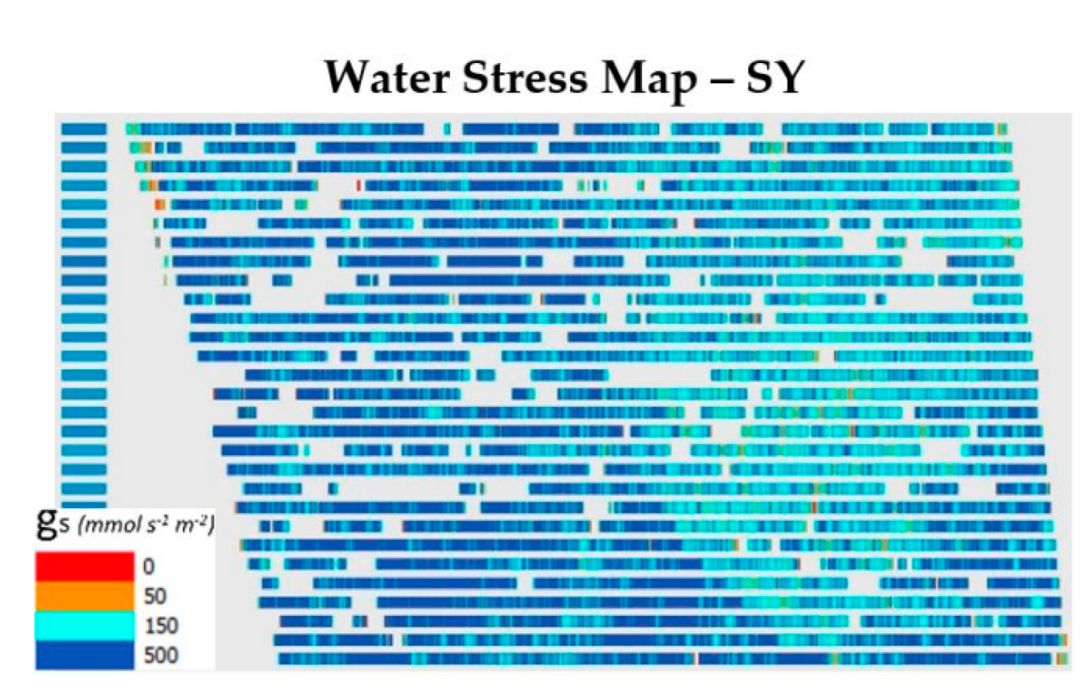
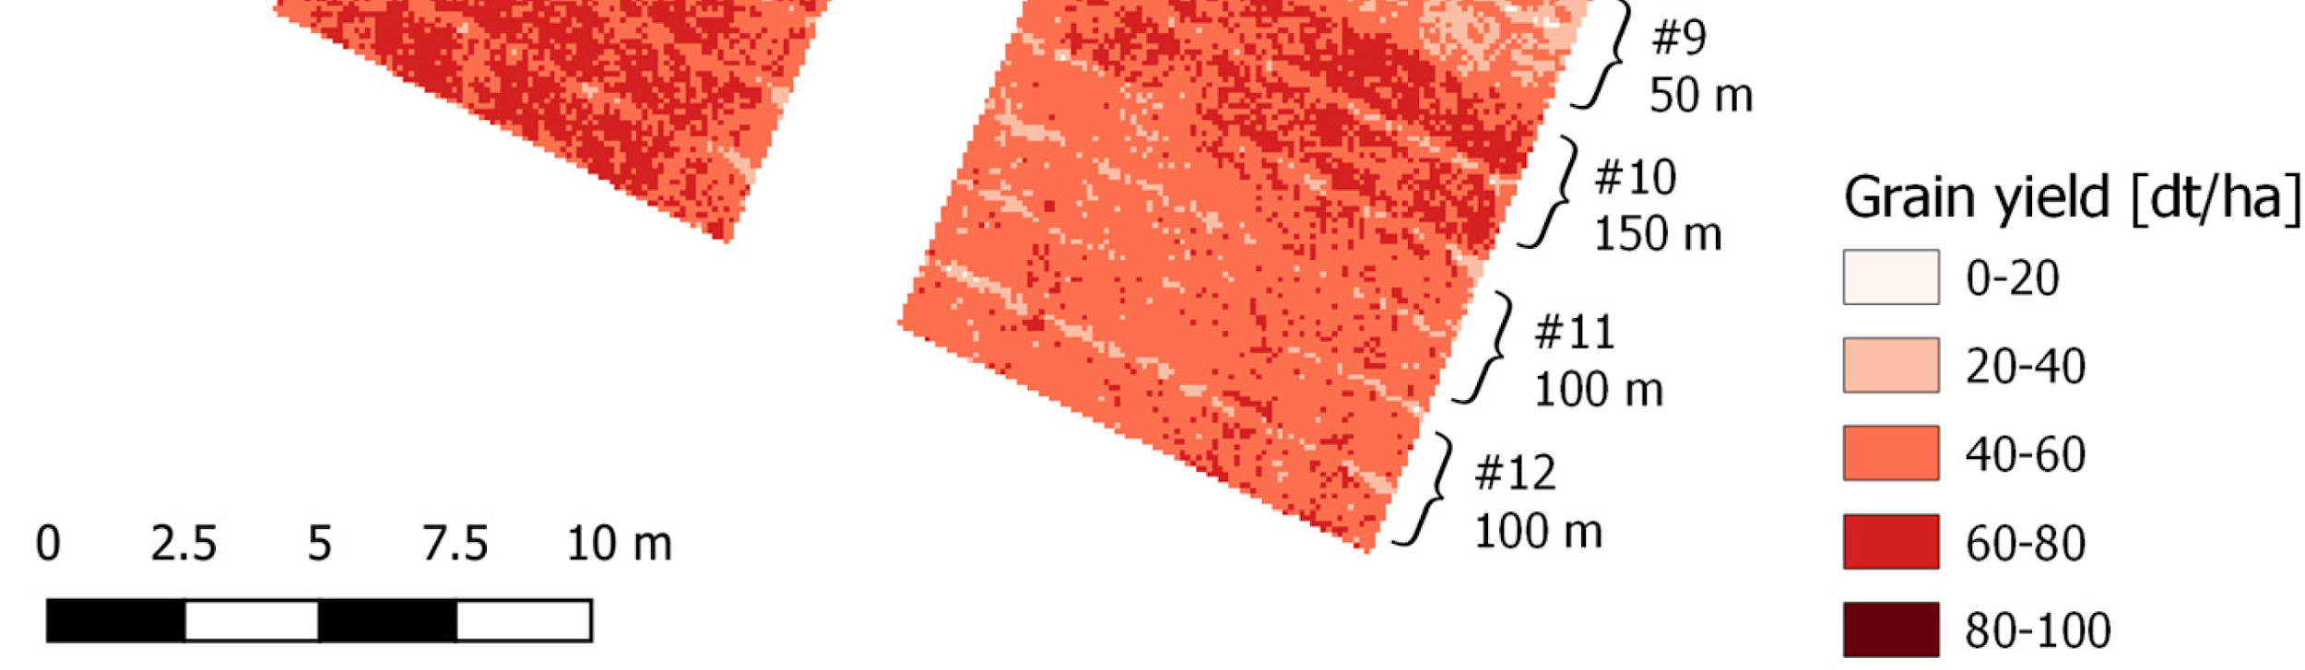
Potential solutions with UAV
Category | Topic | Current service to grower by FarmX | Challenges
Interpretation | Visual analysis | Visualize satellite image on FarmMap | The spatial resolution (>10m) of satellite data is not enough for visual analysis. (can’t identify each tree)
Recommendation | Water stress | Direct measurement with IR sensors /dendrometers | Acquired data is point base (small coverage by IR, single tree attached with a dendrometer) Whole area can’t be measured for now.
Recommendation | Pest | Nothing | No measure for now
Prediction | Yield prediction | Our original yield prediction model by block level | Actual yield historical need to be prepared by growers Output resolution depends on resolution of actual yield data(by block, by points)
Solution with UAV
Very high-resolution image: : appx. 5-10 cm
Whole area map by comparing between UAV’s thermal image and IR sensor/Dendrometer
Same as above one
Counting trees with UAV image = yield measured data Highly resolution yield prediction map with UAV
Satellite (10m/pixel)
UAV (0.1 m/pixel)
Example of water stress map
on UAV image
Comparison in same vineyard
Example of yield prediction on UAV image

Slide 15
Concepts of our UAV solutions
[For customers]
Provide more detailed information to “premium customers” with additional fee
[For FarmX]
Reinforce FarmX’s strength (fusion of ground sensor network and remote monitoring technologies) through UAV solutions
Find anomaly area by detailed monitoring with UAV image
Propose installing additional ground sensor in anomaly area
Conduct detailed diagnosis by fusion of ground sensor data and UAV
Boosting our exclusive values

Slide 16

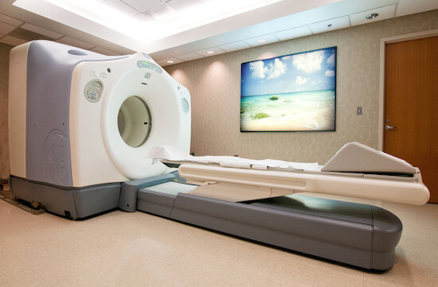
Like a medical diagnosis…
Our existing monitoring like..
Our upcoming service with UAV
Periodic health checkup
Conducted regularly
Low cost
Check sign that something wrong is going to happen
Positron emission tomography (PET)
Conducted when needed
High cost
Scan and provide results in an image about each organ’s condition

Slide 17
Sensors / Technical collaboration
Requirements of sensors mounted on UAV
Items | MicaSense | Sentera | SLANTRANGE | DJI | SONY
Weight [g] | 190 - 350 | 80 - 170 | 250 | N/A | <200
Spectral | RGB Multispectral Thermal | RGB Multispectral | RGB Multispectral | RGB Multispectral | RGB Multispectral
Light sensor | Yes | Yes | Yes | Yes | Yes
Ground sample distance at 120m | < 8.0 cm | < 8.0 cm | < 5.0 cm | < 6.5 cm | < 12 cm
Software for pre-processing | Yes | No | No | No | No
Offer of strategic partnership to us | Yes | No | No | No | Yes
Our demands
<500 (for fixed wing UAV)
RGB Multispectral Thermal
Yes
< 15.0 cm
Yes
Yes/No (either OK)
Best choice for our application

Slide 18
How do we achieve to productization?
Timeline
Q4 2020
Preparation for flight test in 2021
Decide specs of UAV, sensor, field test
Test flight for checking flight procedure, acquired data
Develop data processing flow (pipeline)
2021
Flight in crop growing season
Fly over our current customers’ field
Conduct several times observation per same field
Data analysis
Research on relation between UAV image vs. ground sensor data
Provide whole area map
Dev. data analysis environment
Plan and develop data processing pipeline
Customer response
Get feedback of our prototype
2022
Launch beta version to customers (early adapter)
Visualize output map on FarmMap
Wide range observation
Roles (teams)
Prepare equipment
Flight operation
Coordination with customers
Data analysis
Data processing pipeline
TBD
FarmX

Slide 19
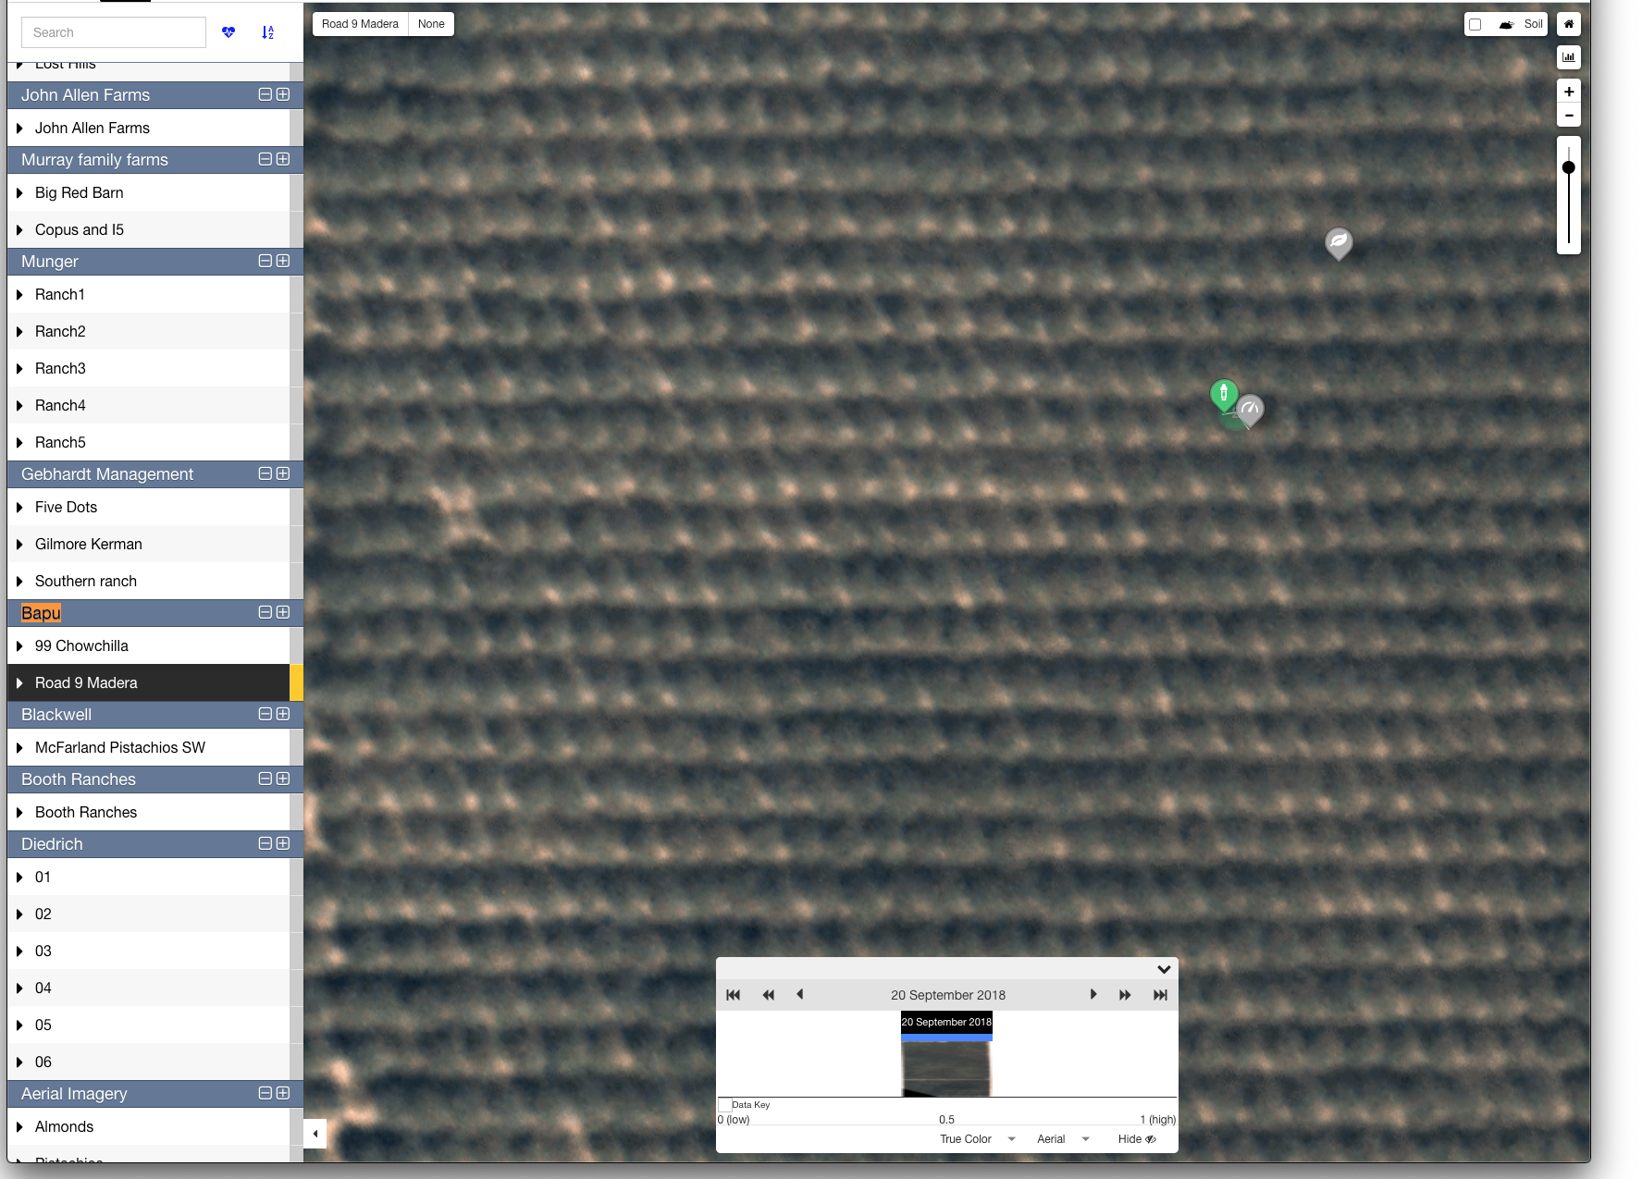
Unsatisfied quality of TerrAvion’s imagery
FarmX acquired aerial imagery from TerrAvion
RGB imagery was blurred caused by out of focus of lens
Atmospheric correction might not be applied well which is very important for calculating vegetation index
Quality may not be stable in different photographed images since they are still in a development phase of sensor
TerrAvion imagery in an almond field

Slide 20
More about Farm(x)
was nice talking the other day.
1. In terms of soil sensors, what would you say are FarmX’ major differentiation points vs. other players active in this space? Such as CropX, Arable, etc.
- we used third party probes. they were inadequate. not a good
measurement radius, and higher power, and higher cost.
- we built our own soil sensor, and pressure for more accurate
modeling and results
2. Or do you see at some point in the future FarmX becoming more focused on the AI/platform side, and less on the hardware itself?
3. In addition, as you mentioned FarmX is (at least initially) targeting high-value specialty crops such as almond, pistachios and berries, does the platform (soil sensor and/or AI algorithms) needs to be customized for each crop type?

Slide 21
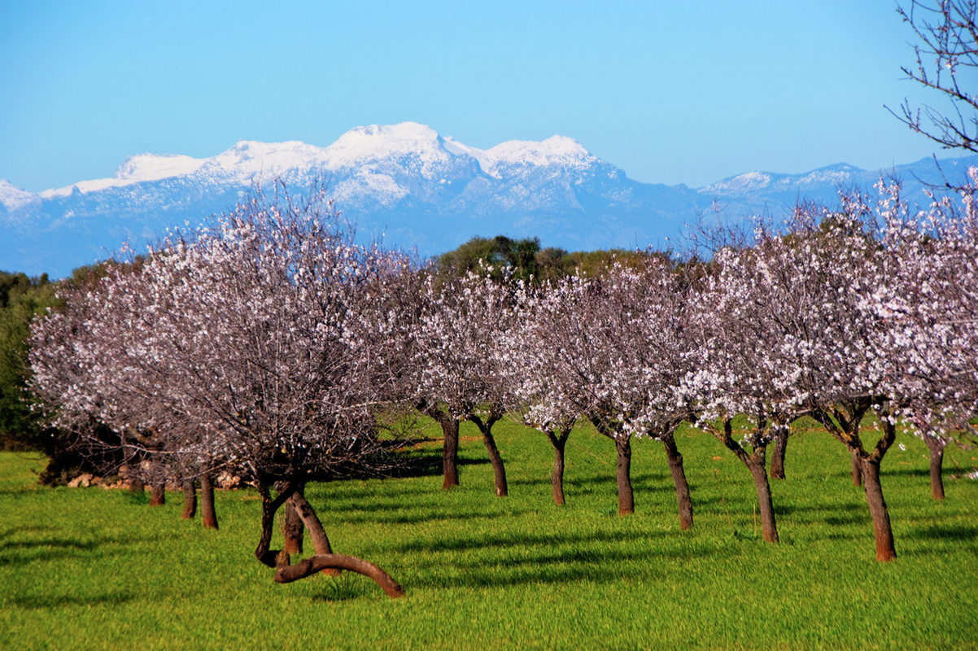
Competitive differentiation

Slide 22
Key points of differentiation
Produce the most complete picture of the farm’s health: from roots to tips: sky to ground
Only company
Offering a battery powered, wireless, IoT based system for collecting ground truth
Highest density data collection
Merging it with 3rd party data such as imaging
Building AI and MI-based modeling
Delivering predictive suggestions for
Irrigation
Yield
Frost management
Delivered in a single dashboard

Slide 23
Slide about network

Slide 24
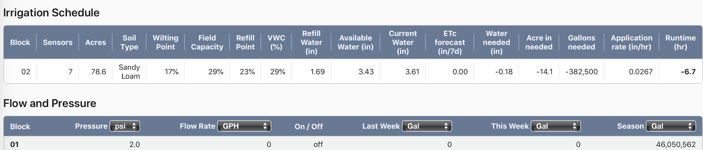
For example . . .
Based on climatic conditions inside the canopy, we determine crop water stress.
We begin with years of canopy data of various types (NDVI, etc.). Then, build an advanced model to identify the real potential problems.
Based on climatic conditions inside the canopy, we determine crop water stress and other factors.
Then, we look at soil moisture and determine what’s happening with water in the root zone and below.
Then, you see your crop’s condition, our suggestions for irrigation, and other data, all in one simple view.
Notes:
QUESTION: NEED EXPLANATINON OF EACH COLUMN AND WHAT DATA MEANS.
Satellite, aerial image
Specific examples of how we uniquely combine some data types that generates unique insights.

Slide 25
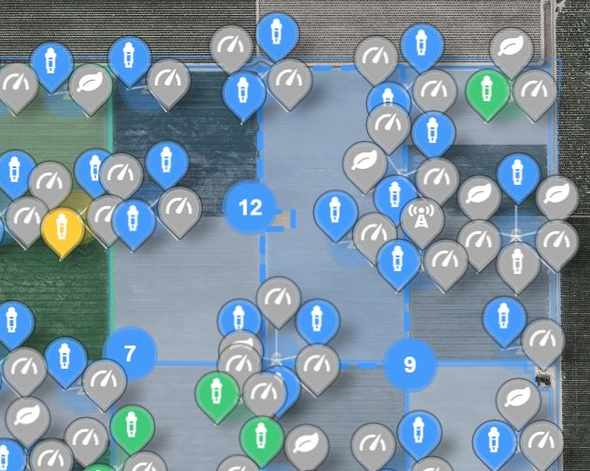
Highest density data collection
3rd party and in-house sensors +
Higher density +
ML-based models + Produces more accurate, more localized recommendations
Enabling more targeted grower action to improve yield
Saving time & cost
Soil sensing
Irrigation control & uniformity
Plant health
Local weather

Slide 26
sensors

Slide 27
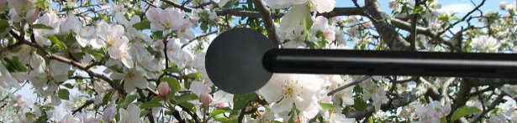
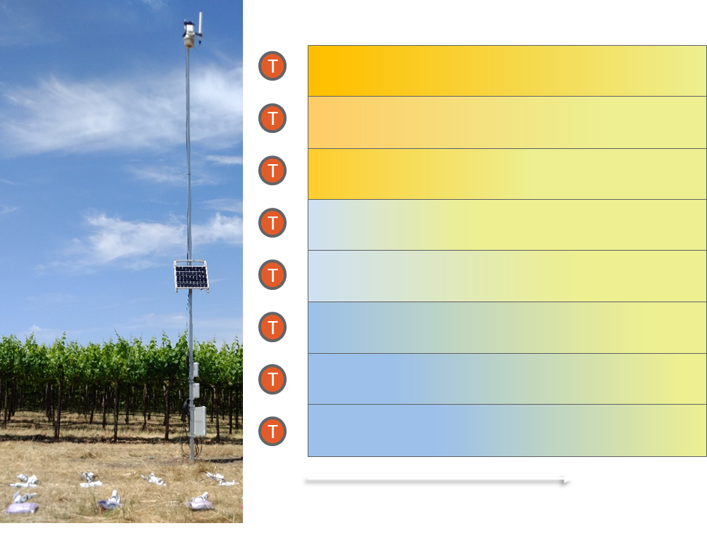
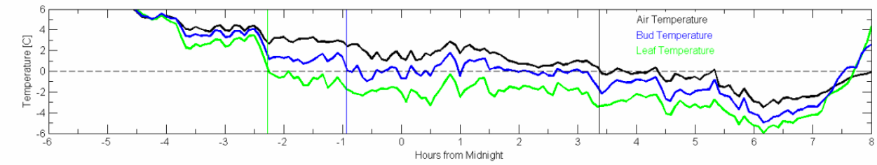
Frost Monitoring & Prediction
Current Solutions: Air temperature based
Air temperature up to 4 degrees warmer than plant
FarmX: Leaf & Bud & Inversion Layer Frost Prediction
Detect frost when leaf & bud temperature get below 0℃
Predict bud & leaf temperature with forecast weather data and machine learning
Daily text alert to grower & field team. 24 hr., 72 hr. & weekly forecast
Inversion layer visualization helps effective mitigation
Frost risk
Air temperature
Bud temperature
Leaf temperature

Slide 28










Crop stress modeling with sensing network
FarmX’s sensing network observes many varieties of elements in farm fields.
This Big Data is not valuable unless labeling and multiplying each other are not achieved.
FarmX is modeling mechanisms of multiple crop stress with the Big Data and Machine Learning.
Crop growth variable
IR sensor
Dendrometer
Images
(vigor, water, thermal)
Stress has several varieties and it is caused by many reasons. Rich environmental data is very helpful to identify causes of stress by multiplying different aspects
Machine Learning Algorithm reveals relationship between input and output and trains model to estimate quantitative of each stress, clarify trigger of occurrences or classify type of stress.
Input
Output
Pressure
Soil sensor
Weather station
Machine Learning Algorithm
Water stress
Frost stress
Pesticide & Disease
Environmental data
Crop stress
Transferred use
Several types of crop growth are observed by sensors or images. Data contains anomalies of growth, and those signals are classified into a specific stress type. For example,
Red leaves in vineyards would affect to photosynthetic active in leaves, and imaging observes and locates loss of vigor
High resolution images from UAV allow to detect abnormal symptoms such as leafroll and crown gall
Input instead of ground sensor data
Prediction
Weather forecasting data
Prediction notifies or warns potential stress before it would become significant damages
©2020 Farm(x) Confidential & Proprietary

Slide 29

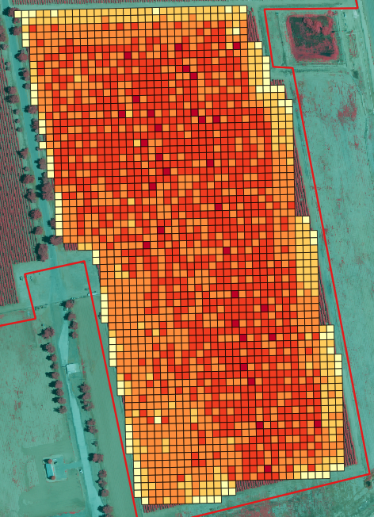
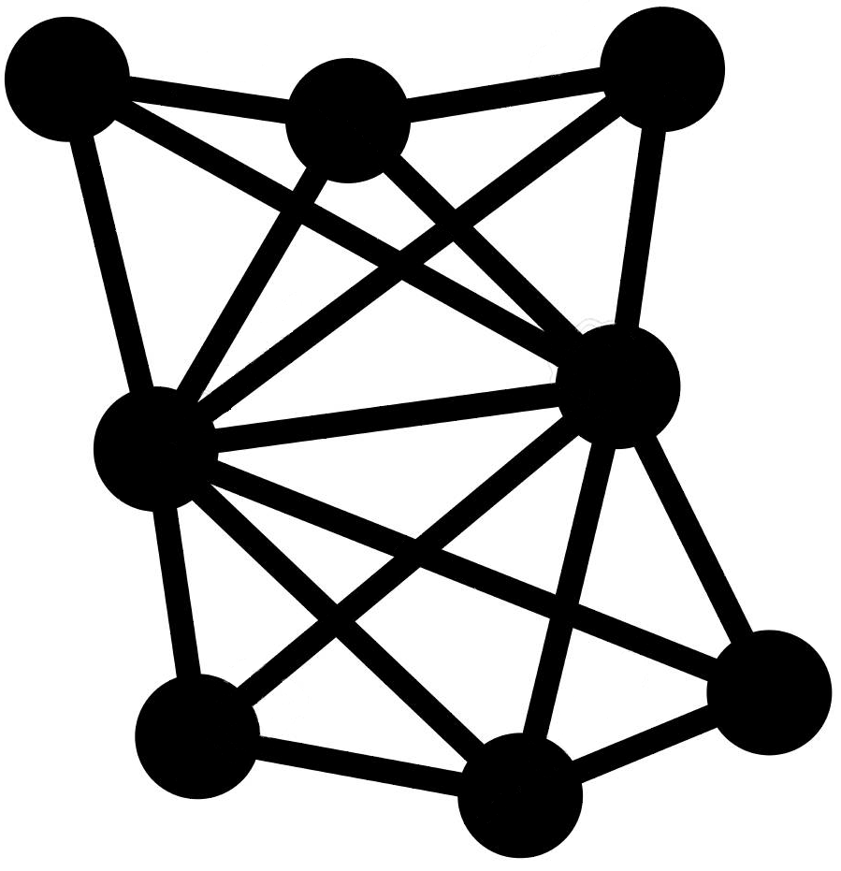

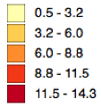





Yield Prediction – ML Engine
Yield mesh map
Indicates variation of productivity
Historical data
𝑓( 𝑥)
Train prediction model
Predicted yield
Crop yield
…
Satellite image
Current data
Expanding prediction in entire fields
Predictions in 10 x 10 m regions
How accurdate have we been?
Plant Soil Imaging Weather Irrigation
©2020 Farm(x) Confidential & Proprietary

Slide 30
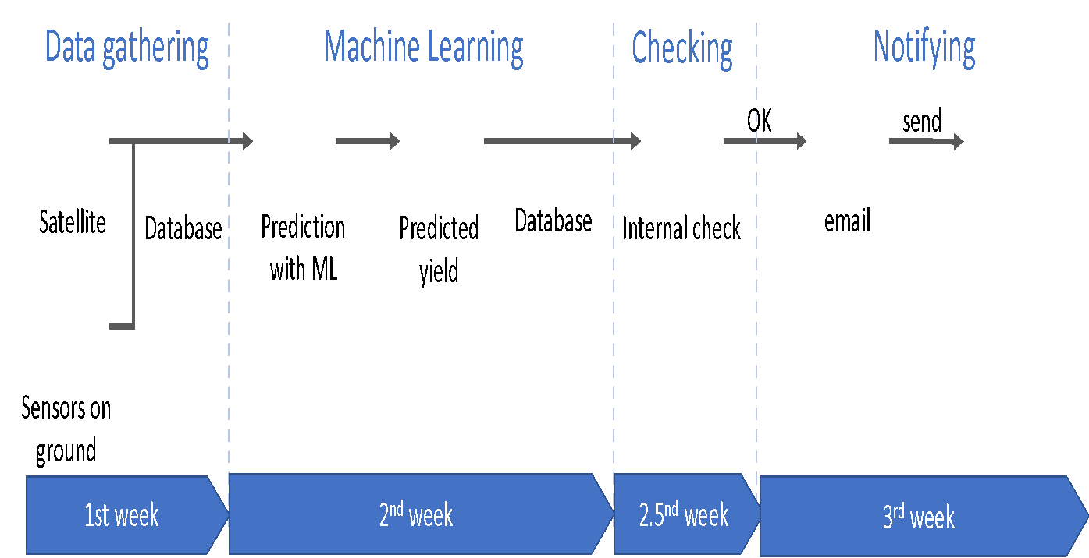
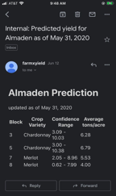
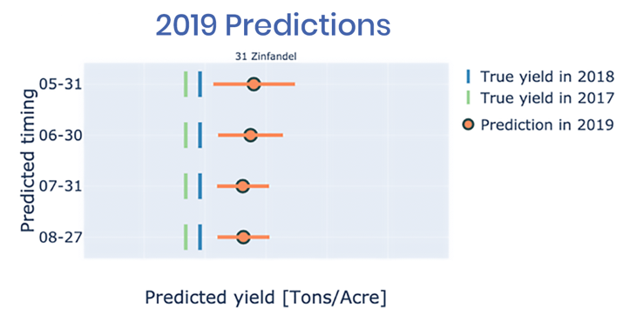
Yield Prediction
Farm(x)’s offering
Starts in June each year thru harvest
96% accuracy
Bi-weekly prediction updates
Email notification
How we do it…
Email report

Slide 31
All these services delivered in a single dashboard
Yield Prediction
3D Soil Moisture Reporting
Plant Health Monitoring
Water & Energy Usage Reports
Soil Moisture Monitoring
Canopy & Anomaly Monitoring
Irrigation Equipment Automation
Frost Prediction
Irrigation Scheduling
In-field Weather Monitoring
Notes:
QUESTION; DESCRIPTION OF SERVICES

Slide 32
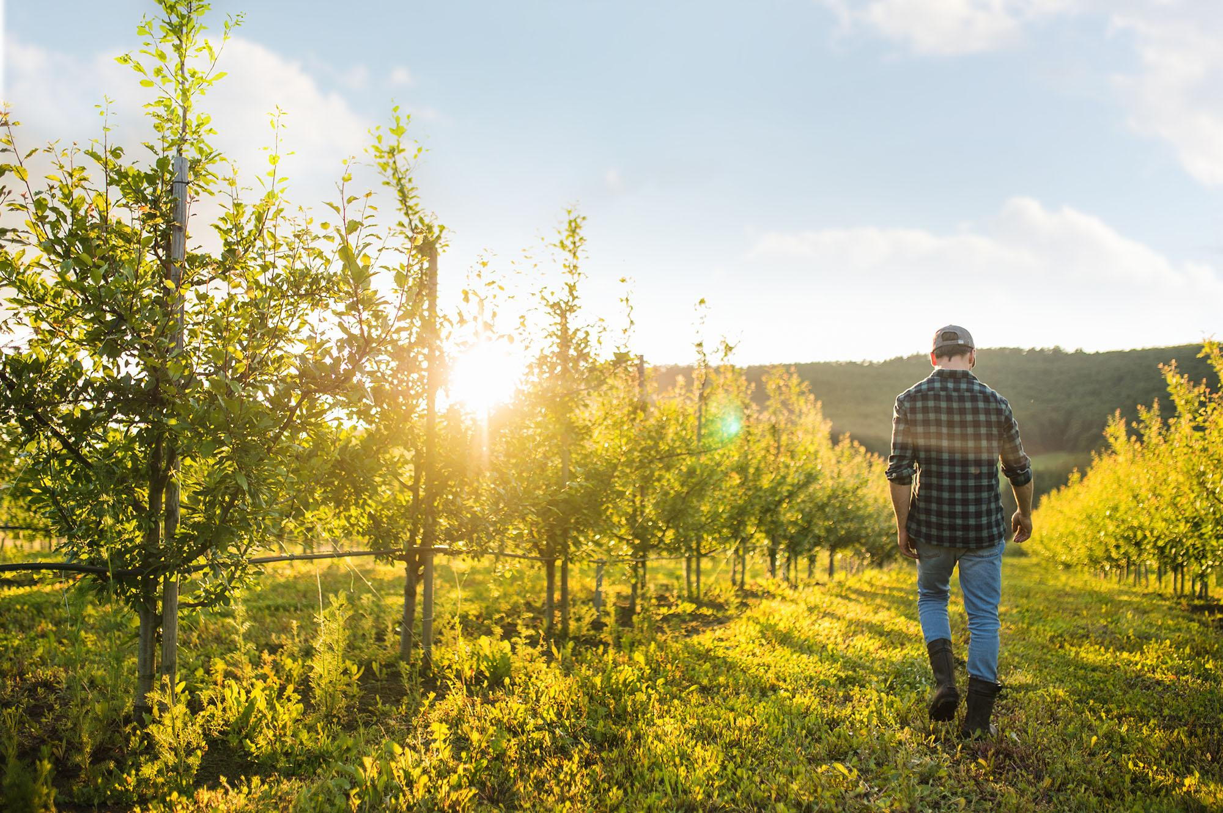
Anchor customers

Slide 33
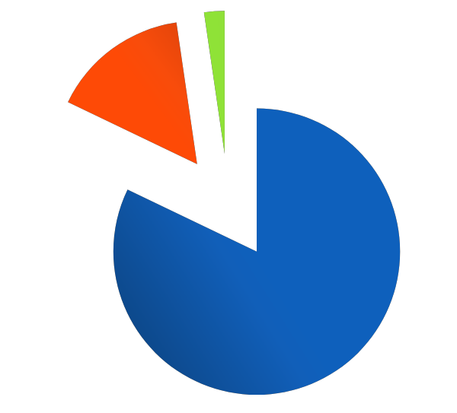
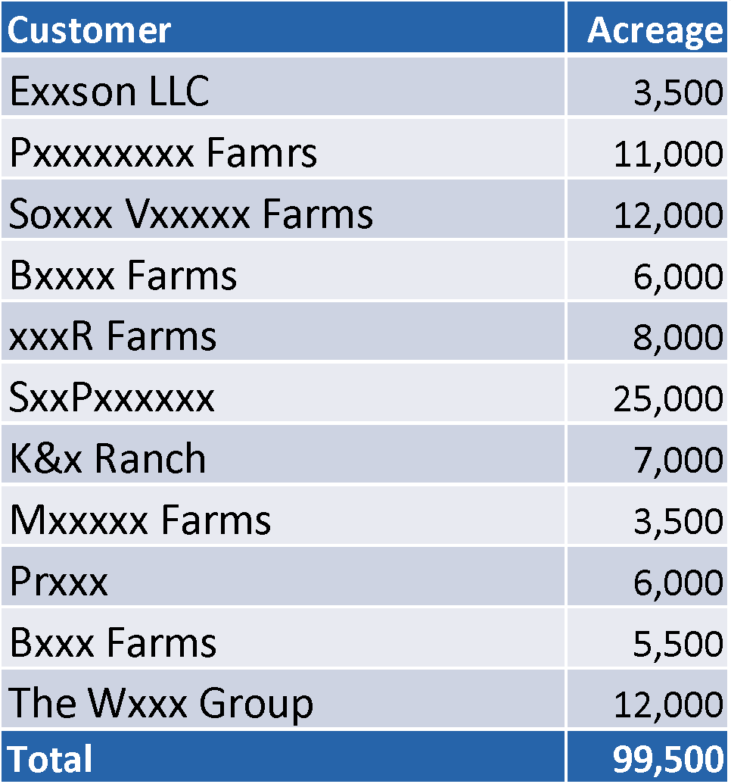

Existing customers gives us access to nearly 100k acres
350,000
In Network
1,850,000
99,500
Direct
Touch
Balance of
California
California Nut, Grape & Fruit Acres
Notes:
Add new pipeline opportunities. Put in alphabetical order.

Slide 34
Anchor Customers NEED the Customer slide
Customer | With Farm(x) | Currently managed | Accessible acreage | % of Holdings
Tulare, CA | 2018 | 867 | 5,430 acres almonds, pistachios | 16%
Madera, CA | 2018 | 454 | 3,212 Almonds, pistachios | 14%
Kettleman, CA | 2018 | 523 | Pistachios | 90%
Notes:
K&G = 160 CH T, Earimart 323 (Dec 2019 SWEEP)+ 334 (Spring 2019 SWEEP), Lakshmi 150
154 Madera + 304 Madera, almonds

Slide 35

Customer benefits

Slide 36
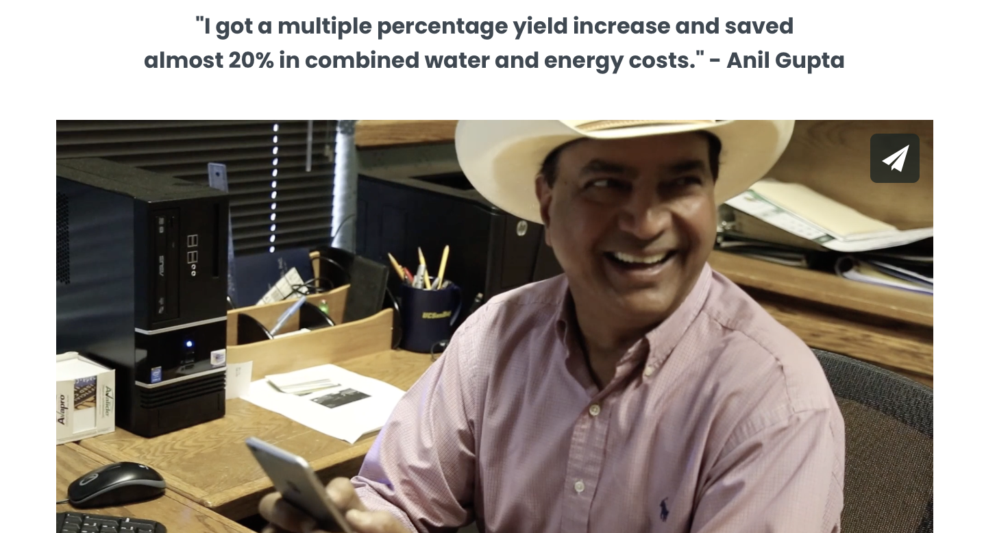
Grower saves 20% in energy and water
5,200 acre grower with 16% under management with Farm(x)
Almonds, pistachios

Slide 37
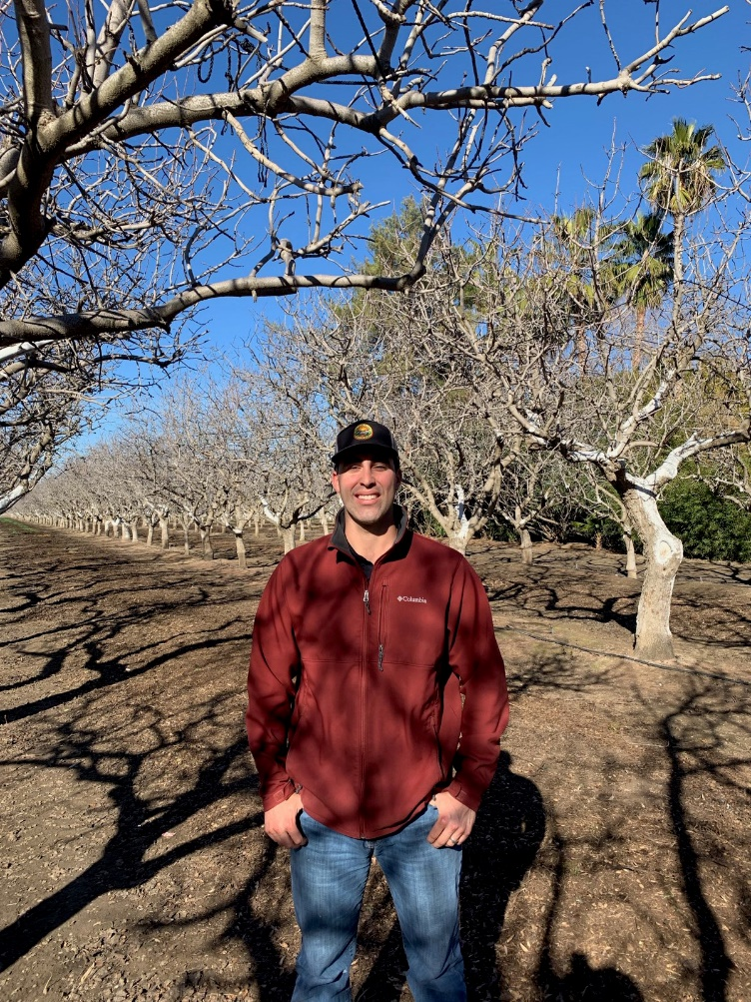
Irrigation Planner - Case Study
Pistachio farm saves water and increases yields
Situation
600 acres of pistachios in the Weslands, CA area
Wanted to monitor water usage in fields
Use less well water
Optimize water during crop growth cycle
Farm(x) solution
Installed pressure sensors, soil sensors in each irrigation block, weather station
Actions taken
Daily look at his irrigation sets results
Used Farm(x) imagery to spot anomalies in plant vigor and growth
Non-uniformity in irrigation
Results
In water constrained years such as 2018, saved 7% of their total farm water usage
Discovered watering past the root zone
Found some trees had been underwatered since their planting. After 2 years, caught up in production
Saw potential additional savings of 10-12% in pumping and power costs
Total savings: 17% to 19%
Notes:
QUESTION: REDUCE WORDS. PROVIDE SPEKER NOTES.
Get Peter’s slides. Why just 7%.? Confirm 10-12%

Slide 38
Summary of Yield Improvements
Yield improvement technique | Deployment Status | Nuts | Grapes
Scheduled watering and fertilization | Deployed | +2% yield | +2% yield
Irrigation distribution uniformity | Deployed | +3% yield | +3% yield
Prevent grape dehydration | Deployed | N/A | +2% yield
Frost prediction | Beta Tested | +5% yield | +3% yield
Yield forecasting | Beta Tested | In Development | +2% yield
Pest and disease forecasting | In Development | +2% yield | +1% yield
Total yield increase |  | +12% yield | +14% yield

Slide 39
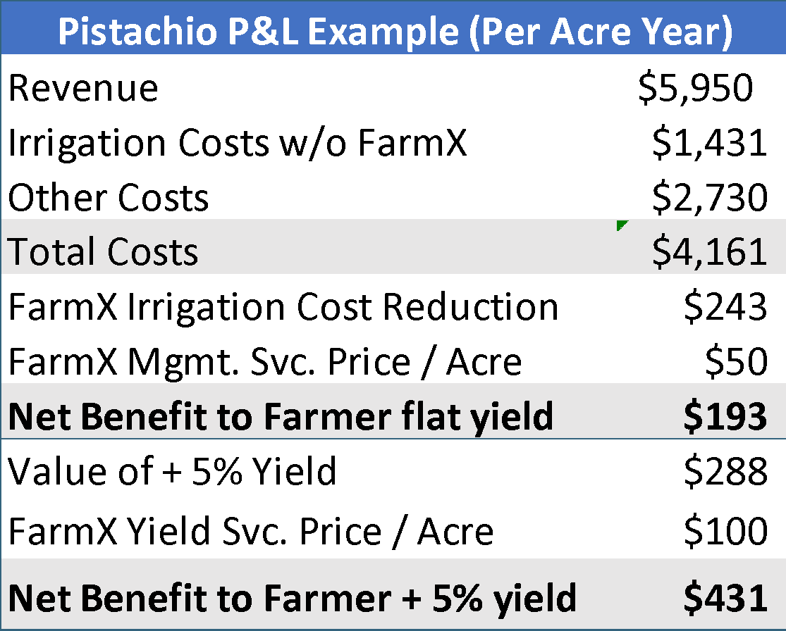
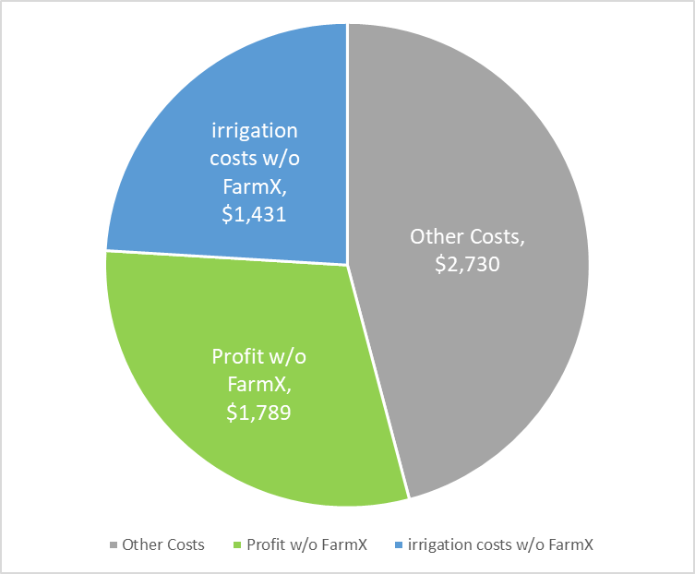
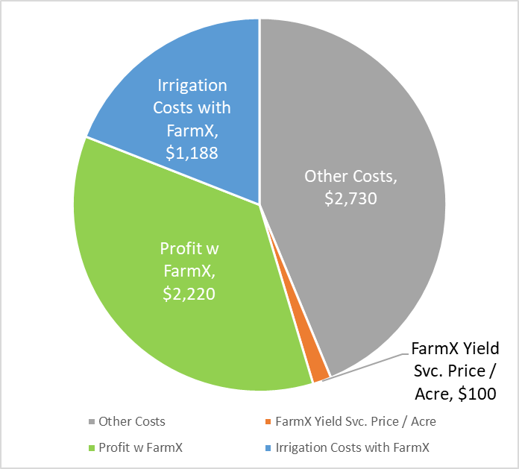
FarmX ROI
Without FarmX
With FarmX
Revenue | $5,950 |  | Revenue | $6,238
Profit | $1,789 |  | Profit | $2,270
FarmX increases farmers’ profits by over 25%

Slide 40
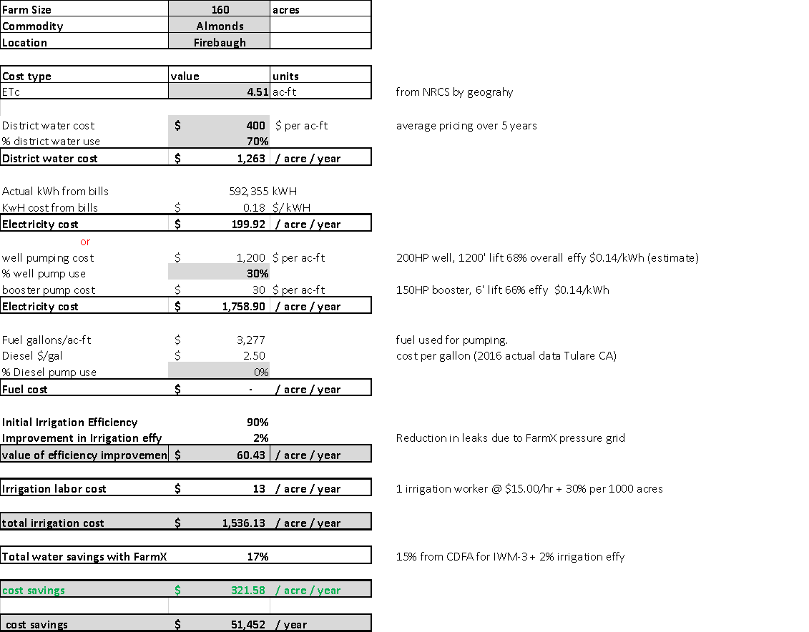
Irrigation ROI Breakout ALMONDS
Key Drivers
70% surface water & 30% well water
Water cost from state & US Gov’t districts ranged from $200 to 1000 / ac-ft during last decade – used average of $400 / ac-ft
In a time of shortage 3rd party water sources charge high rates; $800+ ac-ft
Pumping energy & savings is proportional to amount of well water used and depth of well. In this case the well is 1200 ft deep

Slide 41
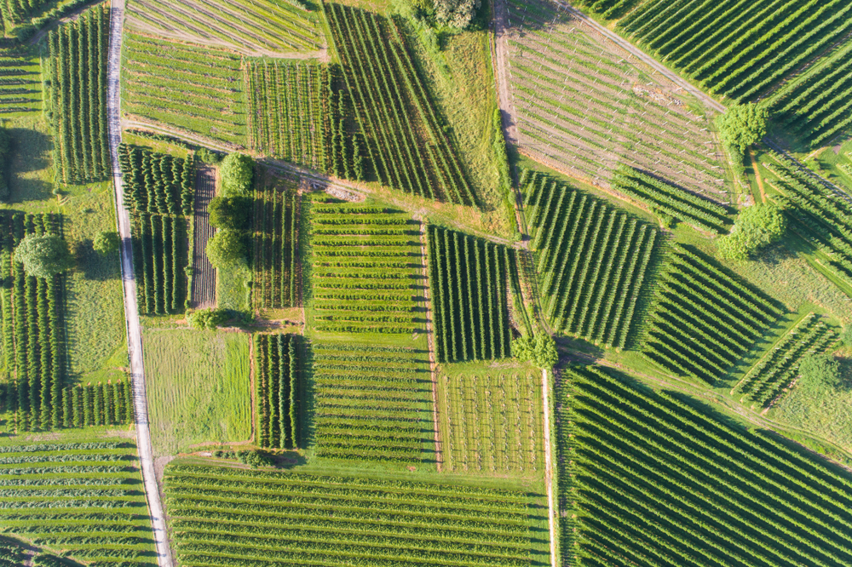
Farm(x) contrasted with the Yield

Slide 42
A high level comparison of Farm(x) and the Yield Based on publicly available data
Area | Farm(x) | The Yield
Services | Water demand | Yes
 | Irrigation uniformity | No
 | Irrigation automation | No
 | ML- based soil percolation modelling and soil type prediction without soil sampling | No
 | ML-based yield forecasting | No
 | Frost Monitoring | No
 | SGMA compliance
Sensors | Range of sensors. In ground, plant, canopy. Sensor agnostic. | Only Bosch sensors. Neither make or use ground sensors.
 | Built a low cost, long range sensor network | Not known
Data sources | Higher density = more data per ranch/farm than competitors Data collection from root zone, in plant, canopy | Yes
Data visualization | 3D modeling, in ground and canopy | Canopy only

Slide 43
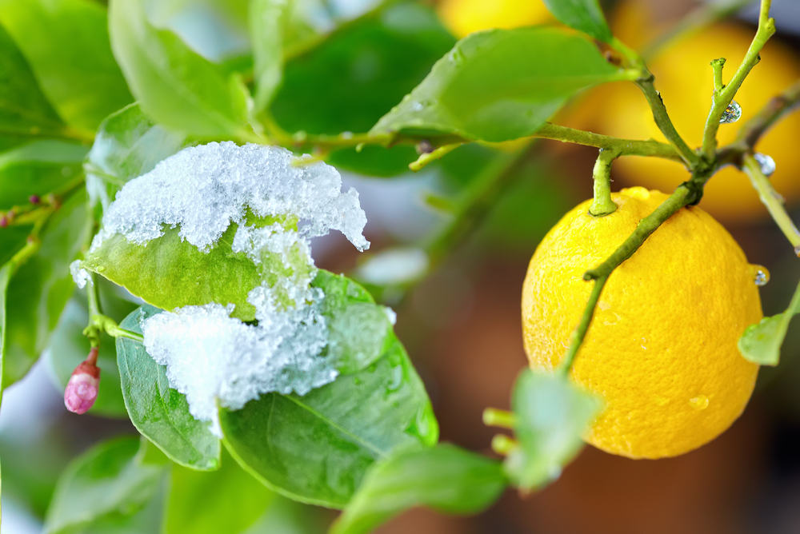
Thank you

Slide 44
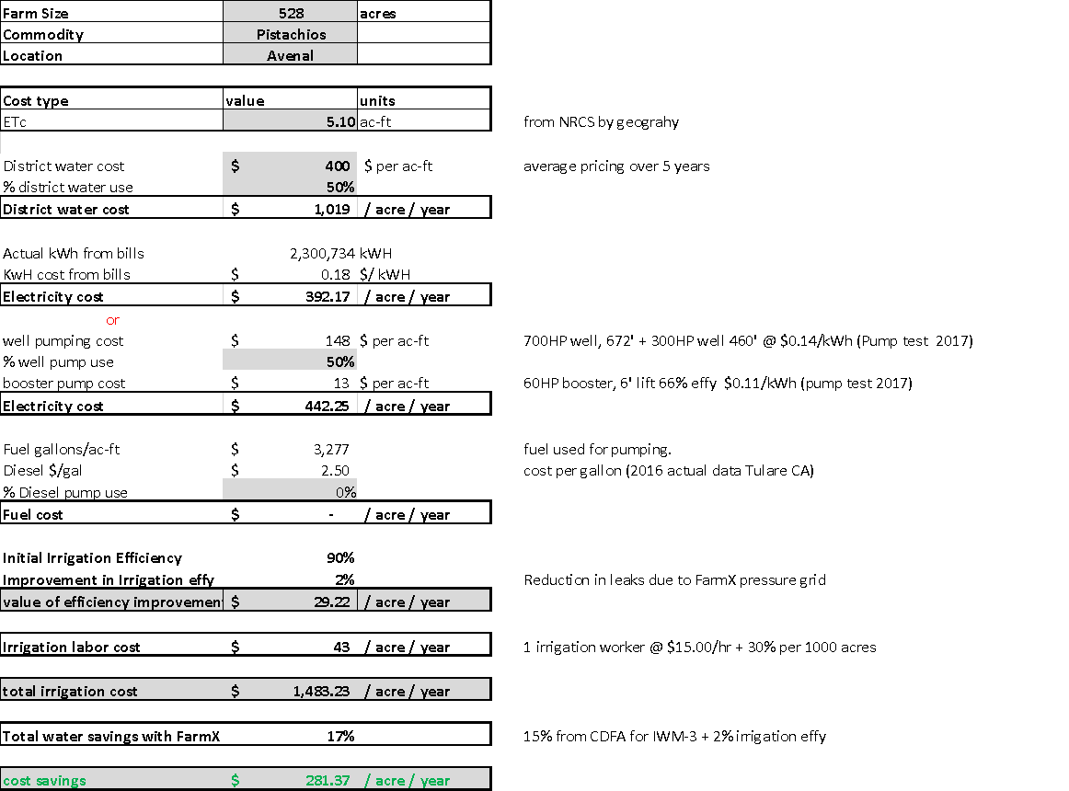
Keenan Water & Energy Savings from Grant
Key drivers background
50% surface water & 50% well water
Water cost from state & US Gov’t districts ranged from $200 to 1000 / ac-ft during last decade – used average of $400 / ac-ft
In a time of shortage 3rd party water sources charge high rates; $800+ ac-ft
Pumping energy & savings is proportional to amount of well water used and depth of well. In this case the well is 670 ft deep
Customer confirmed they saved 7% water in 2018; value of $130 / acre
If they improved practices per FarmX recommendation they would save over $280 /acre
$130/ac savings at 7% less water usage

Slide 45
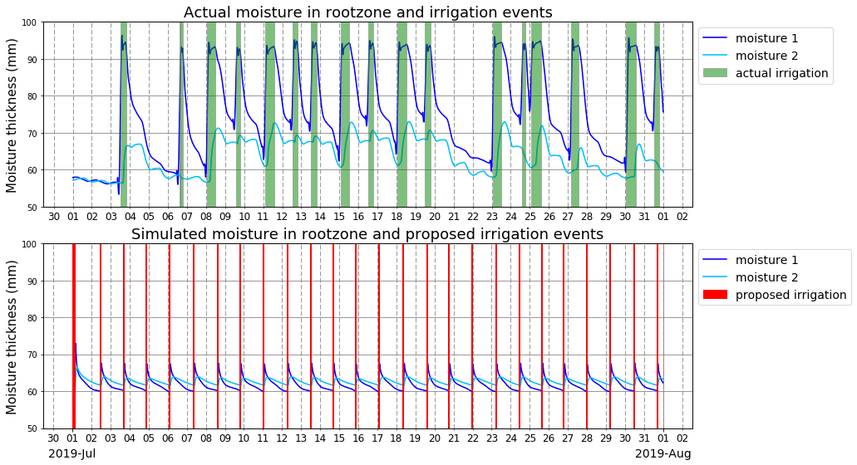
Proposed irrigation schedule by percolation model
Irrigation in an actual vineyard
The top green bar graph shows actual irrigation events detected by a pressure sensor
The bottom red bar graph shows irrigation events proposed by percolation model
Percolation model decided timing and duration of each irrigation event to satisfy 75% of field capacity moisture in the deepest root zone layer
Proposed schedule would execute doubled frequency of actual irrigation events
Total irrigation duration of proposed schedule was 20% of actual irrigation
Actual soil moisture and detected irrigation events by FarmX sensors
Simulated soil moisture and proposed irrigation events by the model

Slide 46
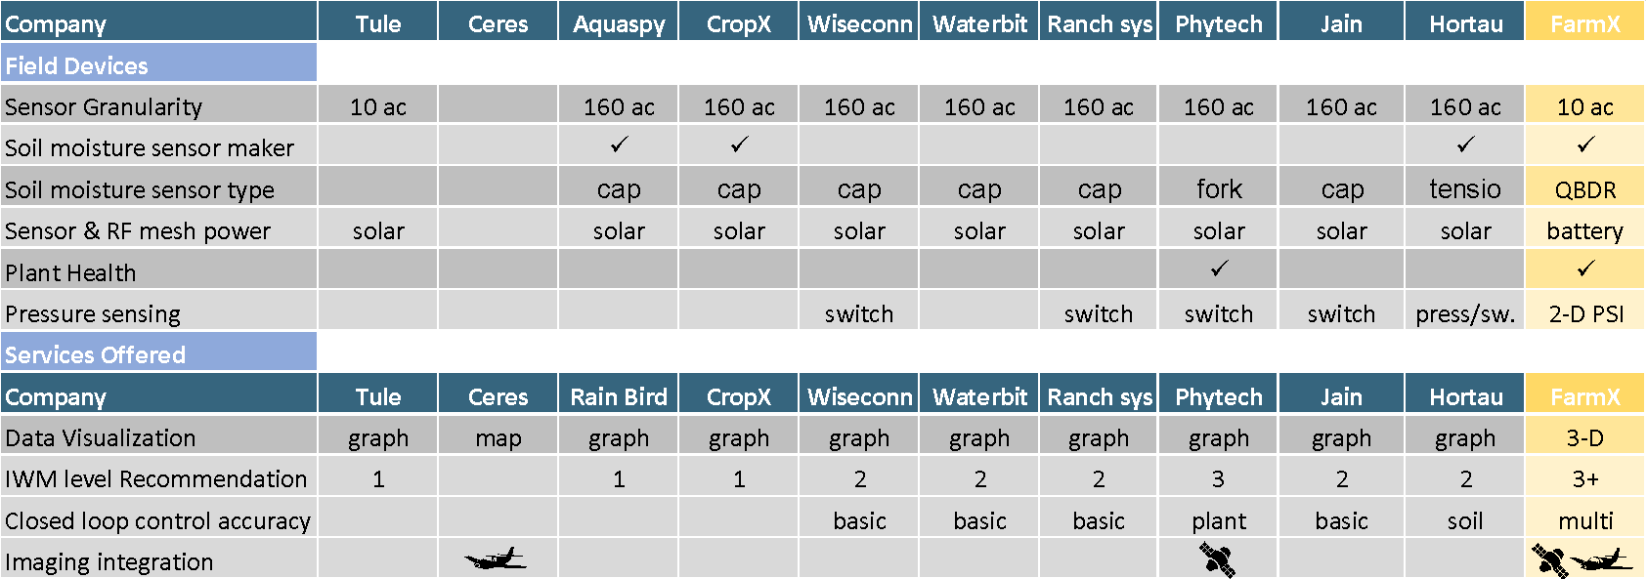
Competitive Landscape
FarmX Unique Offering Benefit to grower
Up to 16x sensor granularity Identify & manage to field variations
Comprehensive sensing Multi-dimensional improvement
Less ancillary hardware due to battery vs. solar node power Lower marginal cost of sensing
Unique soil sensing at 25% of cost Granularity without cost penalty
Highest Accuracy & Efficiency At Lowest Cost

Slide 47


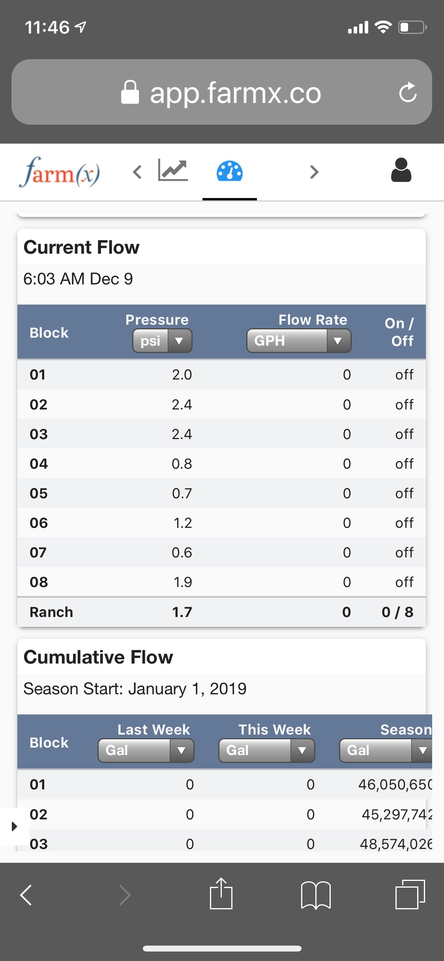
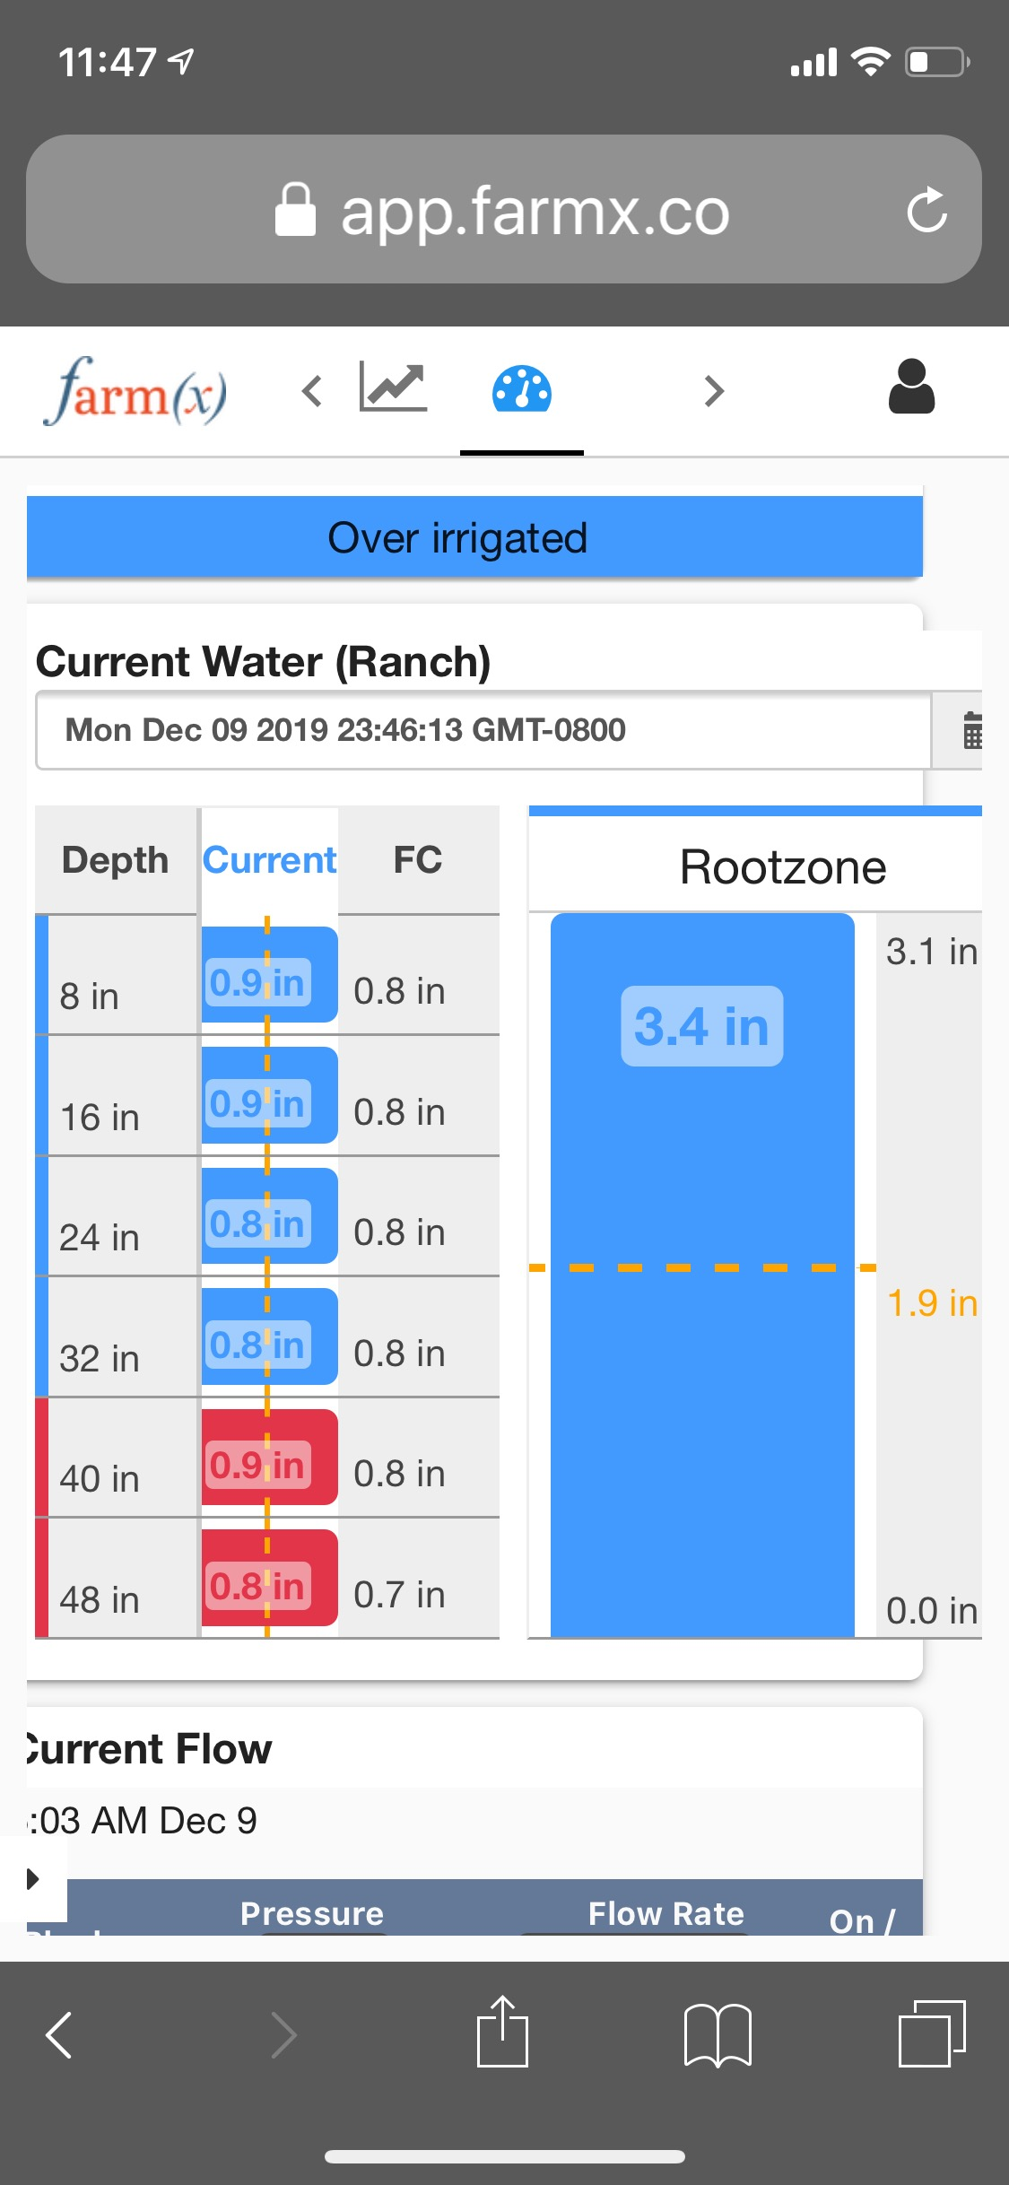





Multi-variable Irrigation Management
Demand of water
Forecast ET
Predicted by forecast weather data and ML
Irrigation management engine
Calculate optimum irrigation based on demand and supply of water
Available water content in rootzone
Estimated by soil percolation model
Crop stress
Observe by satellites & sensors
Irrigation scheduler
Customers can follow our irrigation suggestion
Schedule with their own irrigation on PC or phone
Ability of supplying water
Metadata of irrigation system
Parameters belong to conveyance efficiency, emitter rate

Slide 48
Granularity
More ML and AI
Sensors

Slide 49
Farm(x) Yield Prediction Compared to Competitors
 | Data sources | Services | Farm(x)
Climate.com | Satellite, weather, imagery | Crop health, variable rate seed and fertilization | More services than yield prediction. Yield prediction based on sensors, satellite data. Testing Farm(x)’s solution for data accuracy
Ceres Imaging | Aerial | Identification of irrigation problems, nutrient deficiencies, pest for broad crops. No yield prediction. | Identify irrigation problems, anomaly detection. Yield prediction.

Slide 50
Farm(x)’s yield prediction significantly better
Starts in June each year thru harvest
96% accuracy
Bi-weekly prediction updates
Email notification
How we do it…
Email report

Slide 51
Comprehensive Sensing & Data Collection
Data Needed | FarmX Usage | Sensor(s) | FarmX or third party dev. | Company using data
 |  |  |  | FarmX | CropX | Arable
Imagery | NDVI, NDWI | Satellite, aerial | Third party | ✓ | ✓ | ✓
Weather | ETc, Chill Portions, Irrigation Management | Rain, wind, temp, humidity, solar flux | Third party | ✓ |  | ✓
Plant Health | Crop Stress, Irrigation Management | Infrared Radiometer, Dendrometer | Third party | ✓ |  | ✓
Sub-surface Soil Moisture | Irrigation Management | Sub-surface soil moisture sensor | FarmX | ✓ | ✓ | ✓
Irrigation Water Pressure | Irrigation Management | Water Pressure Sensor | FarmX | ✓ |  | Switch
Water Flow | Irrigation Management | Water Flow Counter | Third party | ✓
System Health | System & battery Health | RF RSSI, Power Stats | FarmX | ✓ | ✓ | ✓
Leaf Wetness | Pest Pressure, Disease Risk, Plant Health | Leaf Wetness | Third party | ✓
Frost | Frost Prediction and mitigation | Bud/Leaf Frost, Inversion Layer Frost | Third party | ✓
51

Slide 52
Reported Savings
 | WET YEAR | DROUGHT YEAR
@ $50/acre for Farm(x) | $100/acre | $200/acre
@ 15% less water usage | 2x savings over Farm(x) costs | 4x savings over Farm(x) costs
Cost of water | $400/AF | $1600/AF
Notes:
640 acre almond ranch Central Valley
Water mix: surface, ground….
Federal district (city, ….)

Slide 53
Summary of Savings
Crop | Acres | Water source | Water Savings | Value of water savings $/ac-yr | Value of Energy Savings $/ac-yr | Total Savings
Pistachios | 528 | 50-50% | 15% | $152 | $53 | $205 / acre / year
Walnuts | 320 | Well | 35% | $210 | $34 | $244 / acre / year
Almonds | 460 | Well | 15% | Not provided¹ | $27 | SWEEP verified
Walnuts | 155 | Well | 35% | Not provided¹ | $52 | SWEEP verified
Almonds | 160 | Surface 70% | 17% | $189 | $30 | Deep wells used 30% of the time
Note: 1 – Verified savings in volume. Do not have information on cost of water

Slide 54
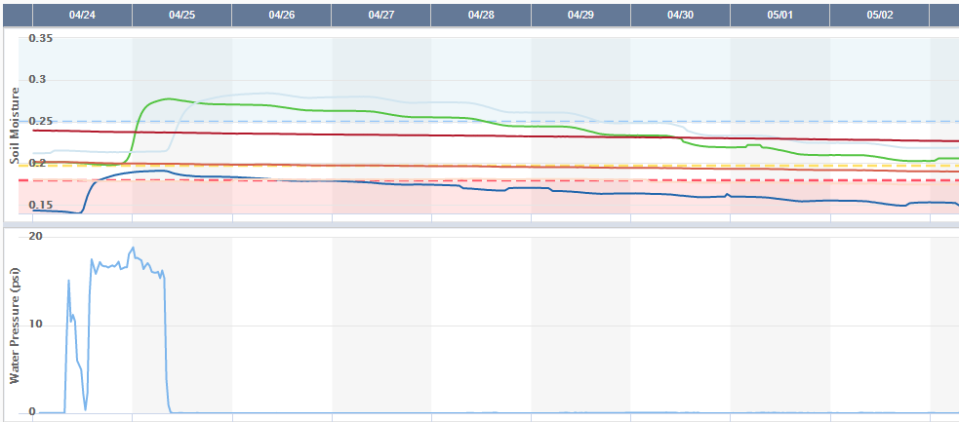
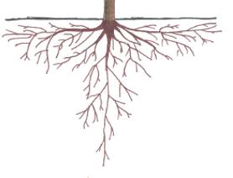
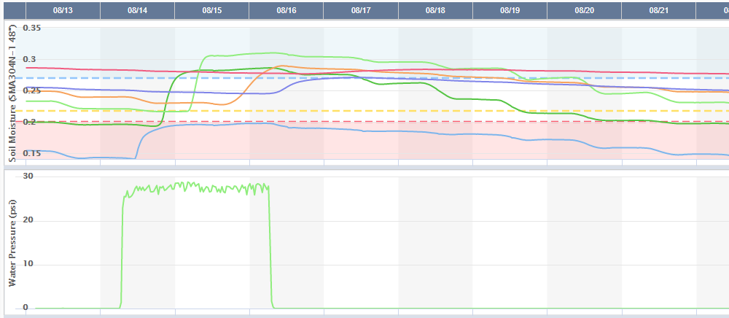
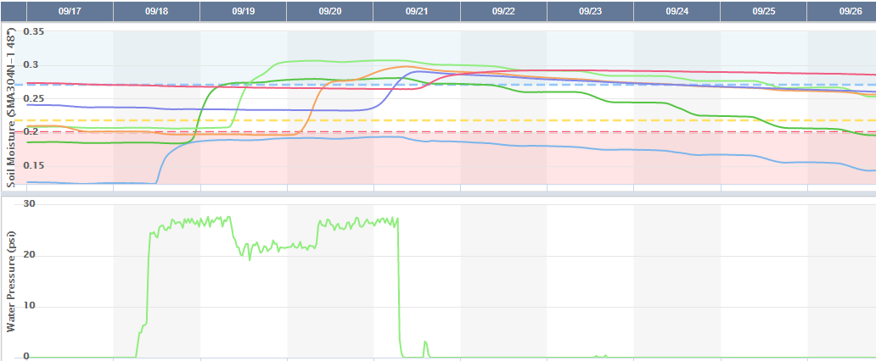
Maximizing Root Zone Efficiency
Good irrigation. No response at 48” but 40” response
8”
16”
24”
32”
40”
48”
Ground Level
Orchard Tree
24 hour irrigation
Feeder roots
borderline irrigation. No response at 48” but 40” response
8”
16”
24”
32”
40”
48”
Irrigation with
fertilizer should not
go below 40”
Waste zone
Tap roots
48 hour irrigation
Bad irrigation. 48” moisture picks up on 9/21
Our solution predicts when water will reach below feeder roots using soil percolation rates
Our sensors measures the water content at depths up to 48 inches
Our irrigation scheduling engine ensures adequate watering and reduce waste by preventing water going below feeder roots
8”
16”
24”
32”
40”
48”
96 hour irrigation

Slide 55
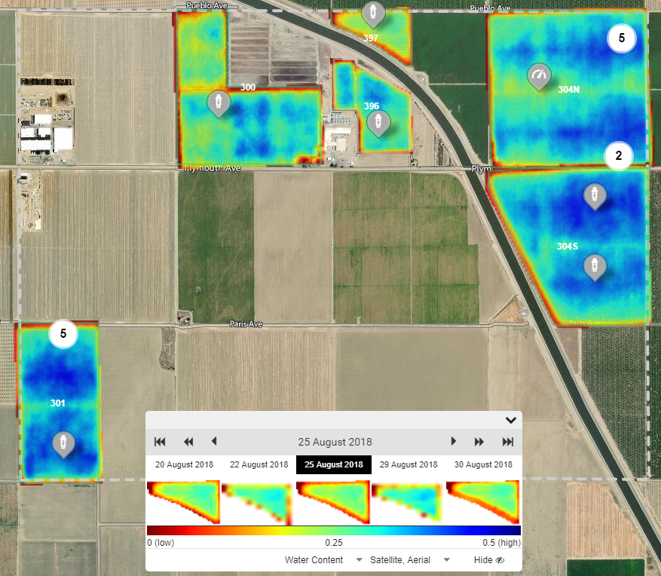
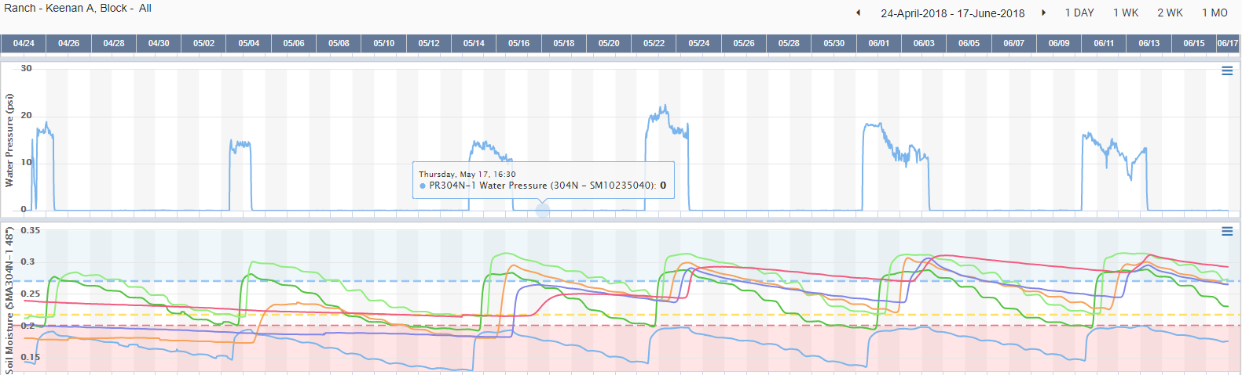
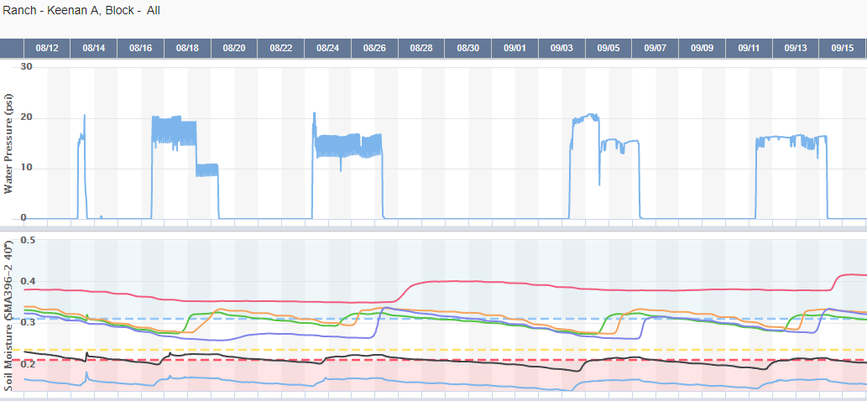
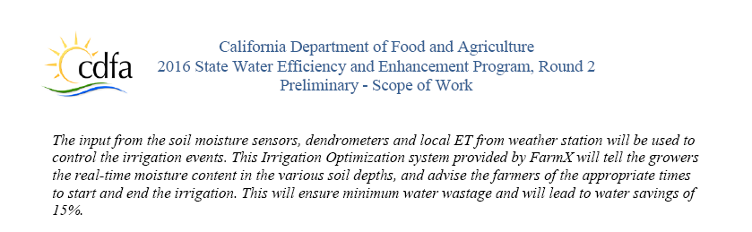

Keenan Farms Could Have Saved More than 7%
8”
16”
24”
32”
40”
48”
8”
16”
24”
32”
40”
48”

Slide 56
Potential Savings
 | WET YEAR | DROUGHT YEAR
@ $50/acre for Farm(x) | $100/acre | $200/acre
@ 15% less water usage | 2x savings over Farm(x) costs | 4x savings over Farm(x) costs
Cost of water | $400/AF | $1600/AF
Notes:
640 acre almond ranch Central Valley
Water mix: surface, ground….
Federal district (city, ….)

Slide 57
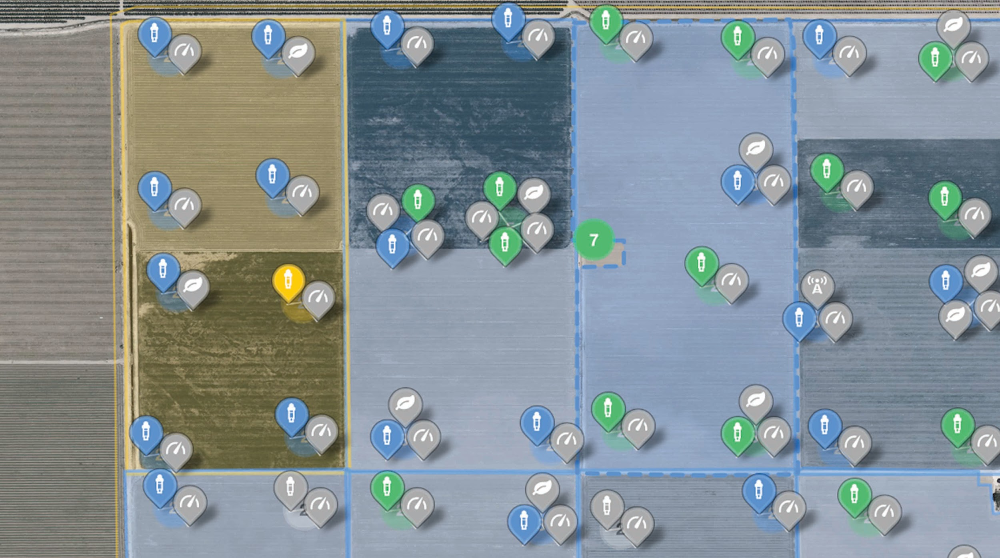
How to Get Started

Slide 58

Customer Benefits

Slide 59
Farm(x) Yield Prediction Compared to Competitors
 | Crops | Data type, Advantages and disadvantages | Services | Vs Farm(x)
agrograph.com | Broad crops | Satellite, proprietary database of 40 million parcels of land, with 10+ years of crop and yield history. Block level | Creditworthiness, crop management | Different crop, financial management focus
fruitspec.com | Citrus fruit | Ground moving sensor, tree level | Fruit volume and the size distribution in a specific orchard, heat-map shows distribution of fruit quantities in an orchard. | Different crop, more expensive – ground sensor based
bountiful.ag | 70K acres of grapes and almonds forecasted in 2019 | Satellite, on weather, remote sensing imagery and geospatial data. 20 years of yield data. Block level | Water and labor savings, yield forecasting | Nearest competitor
Climate.com | Broad crops | Satellite, weather, imagery | Crop health, variable rate seed and fertilization | Broad crop management not focused on vineyards
Ceres Imaging | Broad crops | Satellite imagery | Identification of irrigation problems, nutrient deficiencies, pest | Broad crop focus, just starting. No official offering.

